Slide 1

Evidence Based Approaches
WEEK 6- SLIDE
Evidence based Approaches
Critical research skills and the research process within evidence-based approaches.

Slide 2

Aim
To explore the forms of research

Slide 3

Pair activity-20 minutes
Research Onion Model - Philosophy, Approach, Strategy, Horizon & Data Collection
https://youtu.be/3Z7gGCpVf4w
Identify the two forms of research and importance of each in healthcare practice.

Slide 4

Learning outcomes
Explore the definition of primary and secondary research with examples in healthcare practice
Research on the difference between qualitative and quantitative research?
(Williamson et al., 2011).

Slide 5
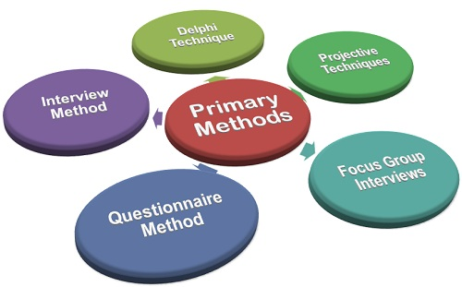
Primary Research: Definition
Primary research is defined as a methodology used by researchers to collect data directly, rather than depending on data collected from previously done research.
Primary Data → Raw data or primary data is a term for data collected at source. ...
Technically, they “own” the data. Primary research is solely carried out to address a certain problem, which requires in-depth analysis (Hox, 2005).

Slide 6
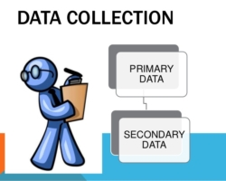
(Libguides.ithaca.edu, 2019)

Slide 7

Forms of research
There are two forms of research:
Primary Research
Secondary Research

Slide 8
The Difference between...
Primary Research
New and original - no one's done it before
Usually has a specific purpose
Secondary Research
Research done by somebody else
One resource won’t be enough to answer your EBP question!

Slide 9
Primary research – what is it?
Primary research involves gathering data that has not been collected before. It can include interviews, surveys or any type of research that you go out and collect yourself. The primary research will in turn act as a primary source such as an original study, document, object or eyewitness account. You may need to conduct primary research if there is little data available on a subject or you want to compare results to existing research.
This type of research differs from secondary research which involves collecting data that already exists. A discussion or evaluation on the findings of a primary source or an analytical report on the way an original piece of research was performed is a secondary source.
Primary research can be useful not just in academic settings but in the workplace and in our personal lives. Primary and secondary research can be used together. For example if you want to support your primary evidence you may want to quote from an interview and use the opinions of other authors who have critiqued or evaluated the way a piece of research was done.

Slide 10
Key forms of primary research
Before deciding on the form of your primary research think about which method is the most appropriate for the area under investigation. You will also need to consider what technology you wish to use and which best fits the specific nature of your research, particularly if you are working at postgraduate research level.
Interviews
These may be face to face, over the phone or via email. Think about the technology you have and choose the form that you are comfortable with. Think also about the impact of the technology used in the responses. Be prepared with your questions, pay attention to what is being said, and don’t get distracted by other topics.

Slide 11


Different Primary Research options…
Questionnaires
Interviews
Focus Groups
Field Notes, Videos, Recordings etc
Case Studies
Two most common ones

Slide 12
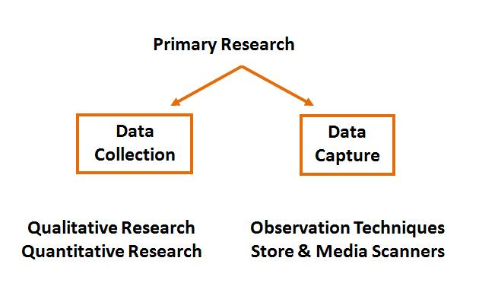
(Libguides.ithaca.edu, 2019)

Slide 13

What is an example of primary research?
Primary research is any type of research that you collect yourself.
Examples include
Surveys,
Interviews,
Observations, and
(Hox, 2005).

Slide 14
Primary Research Methods & Techniques
Primary Research
Quantitative Data
Qualitative Data
Surveys
Personal interview (intercepts)
Mail
In-house, self-administered
Telephone, fax, e-mail, Web
Experiments
Focus groups
Mechanical
observation
Individual depth
interviews
Human
observation
Simulation
Case studies

Slide 15
Questionnaires and surveys
Think about the particular issue or size of group you want to focus on. Think about the questions you want to ask and how – will this be online or in person for example?
Observations
A useful method for gathering information. It will involve watching how the subjects of your study react with each other or the environment around them.
Analysis
This involves finding patterns and trends in data and creating a set of results from the overall picture. You can use primary sources or new data you have collected yourself.

Slide 16
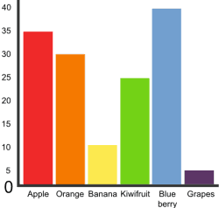
Questionnaires
Provide Quantitative Data – data that can be measured
Tick boxes and, mostly, no more than a few words per answer
Most useful if you want to test
an existing theory or take a
sample of general thoughts

Slide 17

Interviews
Provide Qualitative Data – what do people think and why
Not measurable, but responses are more personal and detailed
Most useful if you want to speak to subject experts, test an exploratory theory or if the meaning can be determined by
context, circumstances etc.

Slide 18
What are qualitative, quantitative and mixed-method methodologies?
Qualitative, quantitative and mixed-methods are different types of methodologies, distinguished by whether they focus on words, numbers or both. This is a bit of an oversimplification, but its a good starting point for understandings. Let’s take a closer look.
Qualitative research refers to research which focuses on collecting and analysing words (written or spoken) and textual data, whereas quantitative research focuses on measurement and testing using numerical data. Qualitative analysis can also focus on other “softer” data points, such as body language or visual elements.

Slide 19
Qualitative methodology
Social research which is carried out in the field (natural settings) and analysed largely in non-statistical ways…Bowling (1997)
Health and Social care reasearch is congruent with qualitative approaches…with its focus on the experiences of people….stresses the uniqueness of individuals….Parahoo (1997)

Slide 20
Quantitative Research
Measures and analyses in a numerical way…
Answers the ‘how many’ ‘A versus B’ survey type where there are a limited number of responses. Structured questionnaires, measuring scales and physiological measurement
Qualitative Research
Asks the why! Gathers non numerical data such as words and text – Interviews and observations

Slide 21
Example of qualitative and quantitative research methods
There are different types of qualitative research methods like an in-depth interview, focus groups, ethnographic research, content analysis, case study research that are usually used. The results of qualitative methods are more descriptive and the inferences can be drawn quite easily from the data that is obtained.
Quantitative data collection methods include various forms of surveys – online surveys, paper surveys, mobile surveys and kiosk surveys, face-to-face interviews, telephone interviews, longitudinal studies, website interceptors, online polls, and systematic observations

Slide 22
Quantitative methodology
To do with gaining new knowledge
Deals with ‘hard’ data, numbers , statistics, structured data and large samples

Slide 23
Introduction to quantitative and qualitative research
Quantitative
deductive
Statistical (numbers)
Causes
Explain
Theory testing
Experimental
Control/rigour/replication
Objective (etic)
Problem known to researcher
Qualitative
Inductive
Understand (words)
Interpret
Find reasons
Experiences of people
Exploratory
Variable not controlled
Subjective (emic)
Little known about phenomenon

Slide 24
Quantitative and Qualitative data
Description | Quantitative Data | Qualitative Data
Purpose | More useful for testing Provides summary information on many characteristics Useful in tracking trends | More useful for discovering Provides in depth (deeper understanding)information on few characteristics Discovers hidden motivations and values
Properties | More structured collection techniques and objective ratings High concern for representativeness Relatively short interviews (1 -20 minutes) Interviewer is passive Large samples (over 50) Results objective | More unstructured collection techniques requiring a subjective interpretation Little concern for representativeness Relatively long interviews (1/2 to many hours) Interviewer is active and should be highly skilled Small samples (1-50) Results subjective

Slide 25
Quantitative research methods are used to gather numerical information. This research method is particularly useful if you are seeking to count, categorise, measure or identify patterns in data. To collect quantitative data, you might choose to conduct experiments, tests or surveys.
Qualitative research methods are used to gather non-statistical data. Instead of using numbers to create charts or graphs, you will need to categorise the information according to identifiers. This research method is most useful if you are seeking to develop a hypothesis. To collect qualitative data, you might choose to conduct focus groups, interviews or observations.

Slide 26
It’s quite common for a qualitative methodology to be used when the research aims and objectives are exploratory in nature. For example, a qualitative methodology might be used to understand peoples’ perceptions about an event that took place, or a candidate running for president.
Contrasted to this, a quantitative methodology is typically used when the research aims and objectives are confirmatory in nature. For example, a quantitative methodology might be used to measure the relationship between two variables (e.g. personality type and likelihood to commit a crime) or to test a set of hypotheses.
As you’ve probably guessed, the mixed-method methodology attempts to combine the best of both qualitative and quantitative methodologies to integrate perspectives and create a rich picture.

Slide 27
Qualitative methods
Qualitative research is a method that collects data using conversational methods, usually open-ended questions. The responses collected are essentially non-numerical. This method helps a researcher understand what participants think and why they think in a particular way.
Types of qualitative methods include:
One-to-one Interview
Focus Groups
Ethnographic studies
Text Analysis
Case Study

Slide 28
Quantitative methods
Quantitative methods deal with numbers and measurable forms. It uses a systematic way of investigating events or data. It answers questions to justify relationships with measurable variables to either explain, predict, or control a phenomenon.
Types of quantitative methods include:
Survey research
Descriptive research
Correlational research
Remember, research is only valuable and useful when it is valid, accurate, and reliable. Incorrect results can lead to customer churn and a decrease in sales.

Slide 29
It is essential to ensure that your data is:
Valid – founded, logical, rigorous, and impartial.
Accurate – free of errors and including required details.
Reliable – other people who investigate in the same way can produce similar results.
Timely – current and collected within an appropriate time frame.
Complete – includes all the data you need to support your business decisions.

Slide 30
Data collection tools
Techniques or tools used for gathering research data include:
Qualitative Techniques or Tools | Quantitative Techniques or Tools
Interviews: these can be structured, semi-structured or unstructured in-depth sessions with the researcher and a participant. | Surveys or questionnaires: which ask the same questions to large numbers of participants or use Likert scales which measure opinions as numerical data.
Focus groups: with several participants discussing a particular topic or a set of questions. Researchers can be facilitators or observers. | Observation: which can either involve counting the number of times a specific phenomenon occurs, or the coding of observational data in order to translate it into numbers.
Observations: On-site, in-context or role-play options. | Document screening: sourcing numerical data from financial reports or counting word occurrences.
Document analysis: Interrogation of correspondence (letters, diaries, emails etc) or reports. | Experiments: testing hypotheses in laboratories, testing cause and effect relationships, through field experiments, or via quasi- or natural experiments.
Oral history or life stories: Remembrances or memories of experiences told to the researcher.

Slide 31
The Other Methods
Focus Groups
Mostly used in market research.
Only useful if you want to canvas opinion on one particular concept. C.f. This
Field Notes
One classic example is Geography field trips.
Best used if you need to observe behaviour, collect samples etc.
Case Studies
An in depth analysis of something bearing close relation to your project. Very time consuming!

Slide 32
Secondary sources of information for a literature
Secondary sources provide second-hand information and commentary from other researchers. Examples include journal articles, reviews, and academic books. A secondary source describes, interprets, or synthesizes primary sources.
This includes peer-reviewed articles, books, dissertations and conference papers. When reviewing the literature, be sure to include major works as well as studies that respond to major works. You will want to focus on primary sources, though secondary sources can be valuable as well.

Slide 33
Methods of Survey Research
Personal interviews
Telephone interviews
Mail Surveys
Electronic/Interactive Surveys
Notes:
Face to face. Can take the form of an intercept (occur on the spot) or pre-planned, pre-recruited.
Has high data quality, but can be costly and time consuming.
Obtaining a random sample of respondents can also be difficult.
Telephone interviews == limited with the kind of stimuli that can be used
high refusal rate
difficult to collect sensitive data
SIMPLICITY in the types of questions asked is key
Mail surveys== Higher response rate relative to other survey techniques
More cost efficient
Highly targetable (Recall PRIZM and GeoVals)
Can be convenient for the respondent, BUT
can suffer from low response rates, SIMPLICITY Key, long lead times

Slide 34
Example of qualitative and quantitative research methods
There are different types of qualitative research methods like an in-depth interview, focus groups, ethnographic research, content analysis, case study research that are usually used. The results of qualitative methods are more descriptive and the inferences can be drawn quite easily from the data that is obtained.
Quantitative data collection methods include various forms of surveys – online surveys, paper surveys, mobile surveys and kiosk surveys, face-to-face interviews, telephone interviews, longitudinal studies, website interceptors, online polls, and systematic observations (Libguides.ithaca.edu, 2019)

Slide 35
Secondary Research: Definition
Secondary research involves the summary, collation and/or synthesis of existing research. Secondary research is contrasted with primary research in that primary research involves the generation of data, whereas secondary research uses primary research sources as a source of data for analysis.
Secondary research or desk research is a research method that involves using already existing data. ... Secondary research includes research material published in research reports and similar documents. These documents can be made available by public libraries, websites, data obtained from already filled in surveys etc.
(Hox, 2005).

Slide 36
What are some examples of secondary research?
Census data collected by the government.
Other population demographics collected by municipal, provincial or federal government agencies.
Reports issued by research institutions.
News reports.
Academic journals.
Newsletters.
Magazines and newspapers.
Pamphlets.
(Libguides.ithaca.edu, 2019)

Slide 37
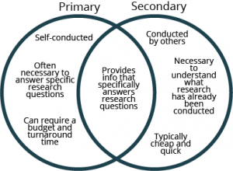
Libguides.ithaca.edu, 2019)

Slide 38
Qualitative research
Research produces is descriptive data that the researcher must then interpret using rigorous and systematic methods of transcribing, coding, and analysis of trends and themes.
Most qualitative studies are small scale, focusing on a single or small number of cases, and they provide depth and contextualised detail. Qualitative research is not a single method but includes a range of designs such as interviews, direct observation, analysis of texts/documents or of audio/video recorded speech or behaviour.
(Meyer, 2000)

Slide 39
Qualitative research is a type of social science research that collects and works with non-numerical data and that seeks to interpret meaning from these data that help us understand social life through the study of targeted populations or places.
Choice of method is often determined by a particular theoretical perspective, such as phenomenology which provides a framework for the research (Meyer, 2000).

Slide 40
Methodologies
Secondary research
Books, newspapers, magazines and websites
Articles published in journals and other
Professional publications
Official statistics (e.g. census data)
Samples and data types

Slide 41
Qualitative methods
Qualitative Research gathers data about lived experiences, emotions or behaviours, and the meanings individuals attach to them.
It assists in enabling researchers to gain a better understanding of complex concepts, social interactions or cultural phenomena.
This type of research is useful in the exploration of how or why things have occurred, interpreting events and describing actions.

Slide 42
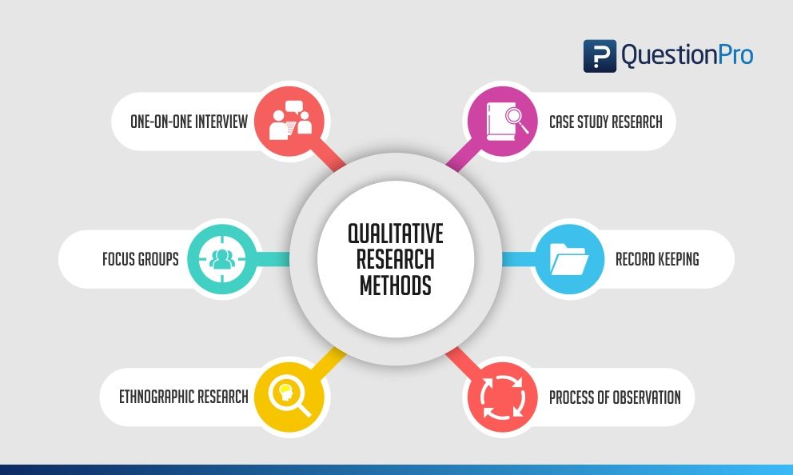
(Meyer, 2000)

Slide 43

Writing methodology example
EXAMPLE:
A secondary (type of research)research approach is proposed for this study by using a qualitative(form of research) data collection method.

Slide 44
Method/ methodology
Your methods section might look like this……..
‘This research project will involve the collection of new data, so is a primary research project. Quantitative data will be collected to answer the research question’
OR
‘The planned research project will utilise a secondary approach and will draw on the qualitative research method’

Slide 45

Quantitative research
Quantitative research
Is defined as a the systematic investigation of phenomena by gathering quantifiable data and performing statistical, mathematical or computational techniques. ... Quantitative research templates are objective, elaborate and many a times, are investigational in nature.
(Williamson et al., 2011)

Slide 46
Quantitative….
This type of research is focused on numbers and measurement, gathering data and being able to transform this information into statistics.
Given that quantitative research is all about generating data that can be expressed in numbers,
There multiple ways you make use of it. Statistical analysis means you can pull useful facts from your quantitative data,
For example trends, demographic information and differences between groups. It’s an excellent way to understand a snapshot of your users.
Through polls, questionnaires, and surveys, or by manipulating pre-existing statistical data using computational techniques.
(Williamson et al., 2011).

Slide 47
What’s the difference between quantitative and qualitative methods?

Slide 48
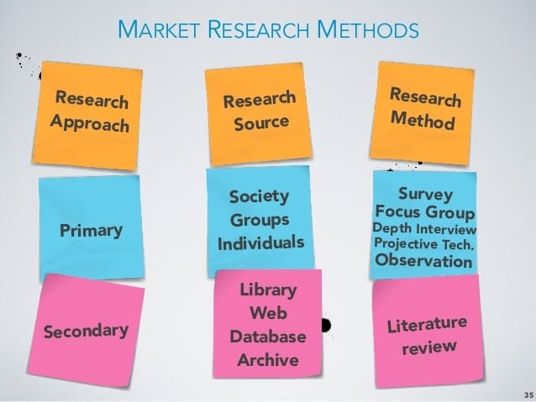
Difference between primary and secondary research
(Hox, 2005)

Slide 49
Quantitative research deals with numbers and statistics, while qualitative research deals with words and meanings.
Quantitative research deals with numbers and statistics, while qualitative research deals with words and meanings.
Quantitative methods allow you to test a hypothesis by systematically collecting and analyzing data, while qualitative methods allow you to explore ideas and experiences in depth.
https://www.scribbr.co.uk/thesis-dissertation/methodology/

Slide 50

What is mixed methods in research?
It simply refers to answering research questions through a combination of qualitative and quantitative data. This might mean running both interviews and surveys as part of a research project or complementing diary study data with analytics looking at the usage of a particular feature (Lieber, 2009)

Slide 51
Mixed methods = Holistic understanding
It makes sense: using both qualitative and quantitative methods to answer a single research question will mean you’re able to build a more complete understanding of the topic you’re investigating.
Quantitative data will tell you what is happening and help you understand magnitude, while qualitative data can tell you why something is happening.
Each type of data has its shortcomings, and by using a mixed methods approach you’re able to generate a clearer overall picture (Lieber, 2009).

Slide 52
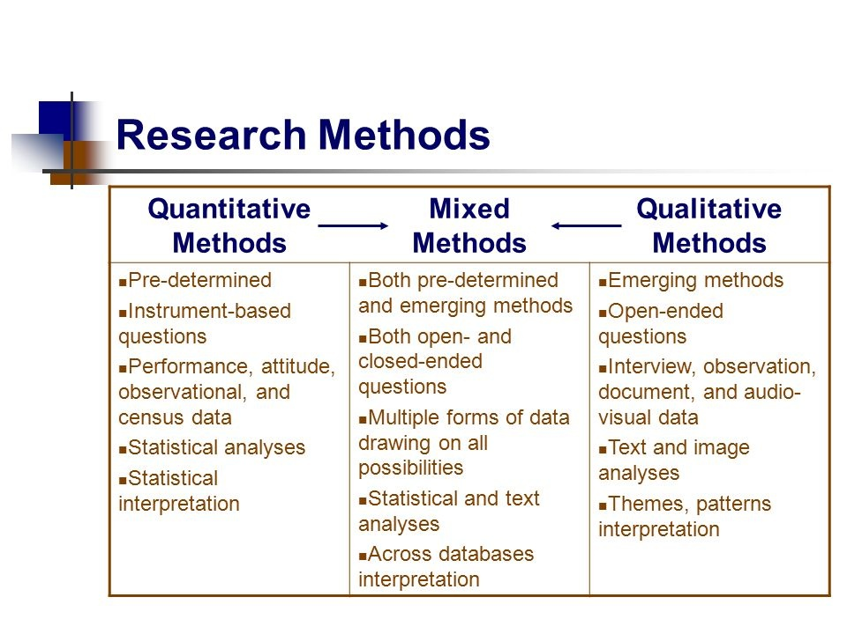
What is mixed methods in research?
(Williamson et al., 2011)

Slide 53
Bibliography
Williamson, G.R., Bellman, L. and Webster, J., 2011. Action research in nursing and healthcare. Sage.
Meyer, J., 2000. Using qualitative methods in health related action research. Bmj, 320(7228), pp.178-181.
Libguides.ithaca.edu. (2019). LibGuides: Research 101: Primary and Secondary Sources. [online] Available at: https://libguides.ithaca.edu/research101/primary [Accessed 12 Nov. 2019].
Hox, J.J. and Boeije, H.R., 2005. Data collection, primary versus secondary.
https://libguides.newcastle.edu.au/researchmethods
Bryman, A., 2006. Integrating quantitative and qualitative research: how is it done?. Qualitative research, 6(1), pp.97-113.
McCusker, K. and Gunaydin, S., 2015. Research using qualitative, quantitative or mixed methods and choice based on the research. Perfusion, 30(7), pp.537-542.
Lieber, E., 2009. Mixing qualitative and quantitative methods: Insights into design and analysis issues. Journal of Ethnographic & Qualitative Research, 3(4).

